Slide 1

AMAZON SALES ANALYSIS
By Priya Kumari

Slide 2
CONTENTS
Business Problem
Project Overview
Dataset Overview
Data Wrangling
Feature Engineering
Exploratory Data Analysis
Questions to Answer
Product Analysis
Sales Analysis
Customer Analysis
Suggestions

Slide 3
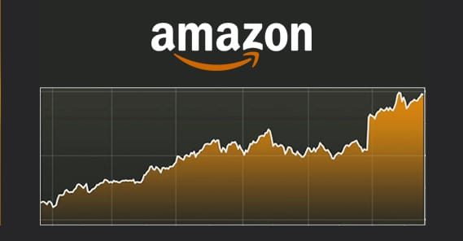
BUSINESS PROBLEM
The major aim of this project is to gain insight into the sales data of Amazon to understand the different factors that affect sales of the different branches.

Slide 4
PROJECT OVERVIEW
The project overview is to understand the different factors that affect sales of the different branches as well as the products.
Optimise the sales strategies to increase the overall profits.

Slide 5
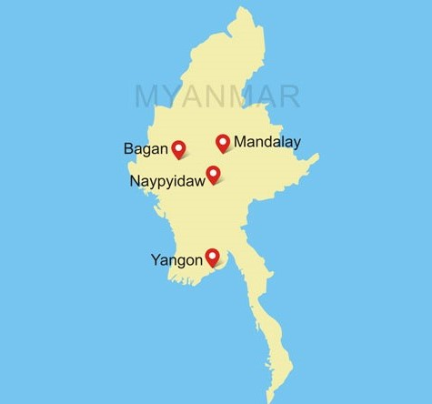
DATASET OVERVIEW
This dataset contains sales transactions from three different branches of Amazon, respectively located in Mandalay, Yangon and Naypyitaw. The data contains 17 columns and 1000 rows.

Slide 6
ABOUT DATA
Column | Description | Data Type
invoice_id | Invoice of the sales made | VARCHAR(30)
branch | Branch at which sales were made | VARCHAR(5)
city | The location of the branch | VARCHAR(30)
customer_type | The type of the customer | VARCHAR(30)
gender | Gender of the customer making purchase | VARCHAR(10)
product_line | Product line of the product sold | VARCHAR(100)
unit_price | The price of each product | DECIMAL(10, 2)
quantity | The amount of the product sold | INT
VAT | The amount of tax on the purchase | FLOAT(6, 4)

Slide 7
Column | Description | Data Type
total | The total cost of the purchase | DECIMAL(10, 2)
date | The date on which the purchase was made | DATE
time | The time at which the purchase was made | TIMESTAMP
payment_method | The total amount paid | DECIMAL(10, 2)
cogs | Cost Of Goods sold | DECIMAL(10, 2)
gross_margin_percentage | Gross margin percentage | FLOAT(11, 9)
gross_income | Gross Income | DECIMAL(10, 2)
rating | Rating | FLOAT(2, 1)

Slide 8
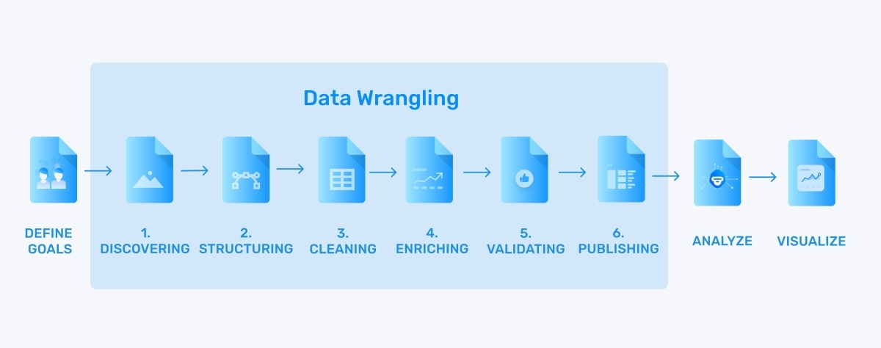

DATA WRANGLING
Data Wrangling is the process of converting raw data into a usable form.
It describes a series of processes designed to explore, transform, and validate raw datasets from their messy and complex forms into high-quality data.
This is the first step where inspection of data is done to make sure NULL values and missing values are detected and data replacement methods are used to replace missing or NULL values.
There are no NULL values in our dataset.

Slide 9
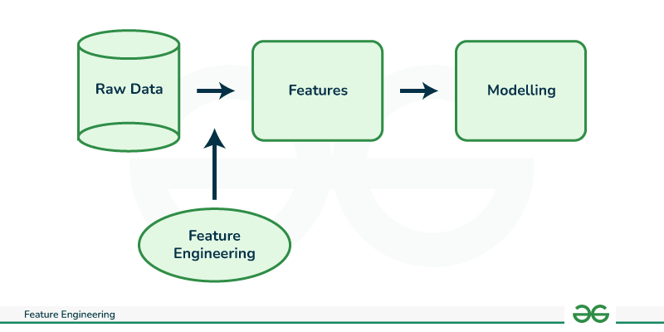

FEATURE ENGINEERING
This will help us generate some new columns from existing ones.
Add a new column named timeofday to give insight of sales in the Morning, Afternoon and Evening.
This will help answer the question on which part of the day most sales are made.

Slide 10

FEATURE ENGINEERING
Add a new column named dayname that contains the extracted days of the week on which the given transaction took place (Mon, Tue, Wed, Thur, Fri).
This will help answer the question on which week of the day each branch is busiest.

Slide 11

FEATURE ENGINEERING
Add a new column named monthname that contains the extracted months of the year on which the given transaction took place (Jan, Feb, Mar).
Help determine which month of the year has the most sales and profit.

Slide 12
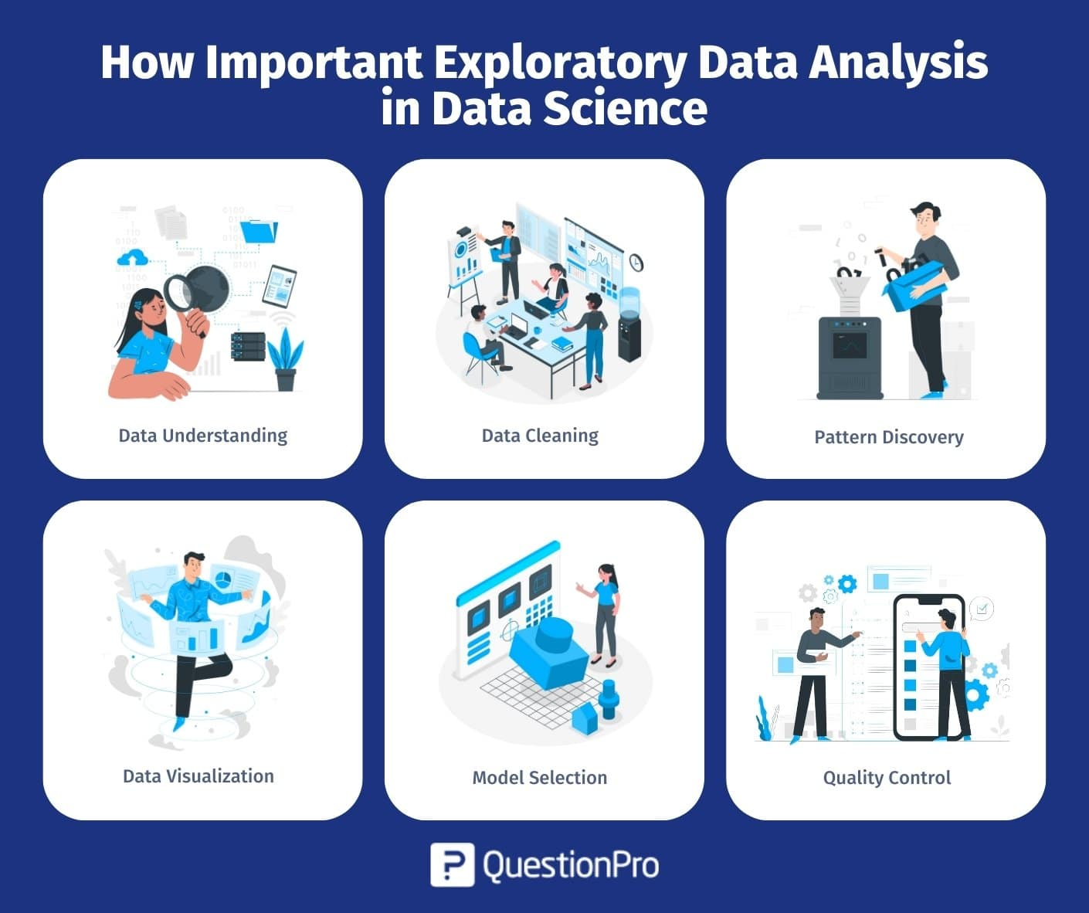
EXPLORATORY DATA ANALYSIS

Slide 13



Business Questions To Answer
1. What is the count of distinct cities in the dataset?
SELECT COUNT(DISTINCT CITY) FROM amazon;
2. For each branch, what is the corresponding city?
SELECT DISTINCT Branch, city FROM amazon;
3. What is the count of distinct product lines in the dataset?
select count(distinct `Product line`) as product_line from amazon ;

Slide 14


Questions To Answer
4. Which payment method occurs most frequently?
SELECT Payment, COUNT(*) as most_freq_mode FROM amazon GROUP BY Payment ORDER BY most_freq_mode DESC LIMIT 1;
5. Which product line has the highest sales?
select `product line`, sum(total) as total_sales from amazon group by 1 order by total_sales desc limit 1 ;

Slide 15


Questions To Answer
6. How much revenue is generated each month?
SELECT monthname, ROUND(SUM(Total),2) as revenue FROM amazon GROUP BY monthname ORDER BY monthname;
7. In which month did the cost of goods sold reach its peak?
select month(date) as month ,sum(cogs)as total_cog from amazon group by 1 order by total_cog desc limit 1 ;

Slide 16


Questions To Answer
8. Which product line generated the highest revenue?
select `product line`, round (sum(`gross income`),2) as total from amazon group by 1 order by total desc limit 1;
9. In which city was the highest revenue recorded?
SELECT city, SUM(total) as total_revenue FROM amazon
GROUP BY city ORDER BY total_revenue DESC LIMIT 1;

Slide 17


Questions To Answer
10. Which product line incurred the highest Value Added Tax?
select `product line` ,round(sum(`Tax 5%`),2)as total_tax from amazon group by 1 order by total_tax desc limit 1 ;
11. Identify the branch that exceeded the average number of products sold.
SELECT Branch, SUM(quantity) as Total_quantity FROM amazon
GROUP BY Branch ORDER BY Total_quantity DESC LIMIT 1;

Slide 18
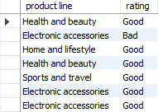
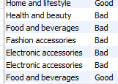
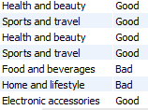
Questions To Answer
12. For each product line, add a column indicating "Good" if its sales are above average, otherwise "Bad."
with Avg_Total AS (
SELECT AVG(Total) AS avg_total FROM amazon) SELECT `product line`, CASE WHEN Total > avg_total THEN 'Good'
ELSE 'Bad' END AS rating FROM amazon
CROSS JOIN Avg_Total;

Slide 19

Questions To Answer
13. Which product line is most frequently associated with each gender?
with gender_product_counts AS ( SELECT Gender, `Product line`, COUNT(`Product line`) AS product_count, ROW_NUMBER() OVER(PARTITION BY gender ORDER BY COUNT(*) DESC) AS rank_num FROM amazon GROUP BY Gender, `Product line`) SELECT Gender, `Product line`FROM gender_product_counts WHERE rank_num = 1;

Slide 20
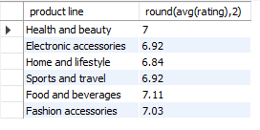
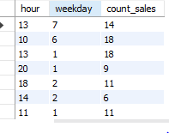
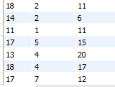
Questions To Answer
14. Calculate the average rating for each product line.
select `product line`, round(avg (rating),2) from amazon group by 1 ;
15. Count the sales occurrences for each time of day on every weekday.
select hour(time) as hour ,dayofweek(date) as weekday ,count(Total) as count_sales from amazon group by 1,2 ;

Slide 21


Questions To Answer
16. Identify the customer type contributing the highest revenue.
select `Customer type`, round(sum(Total),2) as total_revenue from amazon group by 1 order by total_revenue DESC ;
17. Determine the city with the highest VAT percentage.
select City ,round(sum(`Tax 5%`),2) as total_percentage from amazon group by 1 order by total_percentage DESC limit 1 ;

Slide 22


Questions To Answer
18. Identify the customer type with the highest VAT payments.
select `Customer type` ,round(sum(`Tax 5%`),2) as total_percentage from amazon group by 1 order by total_percentage DESC limit 1 ;
19. What is the count of distinct customer types in the dataset?
select `Customer type`, count(distinct `Customer type`) as unique_count from amazon group by 1;

Slide 23


Questions To Answer
20. What is the count of distinct payment methods in the dataset?
select count(distinct Payment) payment_count from amazon ;
21. Which customer type occurs most frequently?
select `Customer type` ,count(`Customer type`) as count_customer from amazon group by 1 order by count_customer DESC limit 1 ;

Slide 24


Questions To Answer
22. Identify the customer type with the highest purchase frequency.
select `Customer type` ,count(quantity) as purchase from amazon group by 1 order by purchase DESC limit 1 ;
23.Determine the predominant gender among customers.
SELECT Gender, COUNT(*) AS gender_count FROM amazon GROUP BY Gender ORDER BY gender_count DESC LIMIT 1;

Slide 25
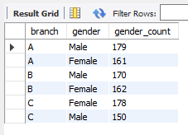
Questions To Answer
24. Examine the distribution of genders within each branch.
SELECT branch, gender, COUNT(*) AS gender_count
FROM amazon
GROUP BY branch, gender
ORDER BY branch, gender_count DESC;

Slide 26


Questions To Answer
25. Determine the time of day with the highest customer ratings for each branch.
select Time, max(Rating) as max_rate from amazon group by 1 order by max_rate DESC limit 1 ;
26. Identify the time of day when customers provide the most ratings.
select Time, count(Rating) as rating_count from amazon group by 1 order by rating_count desc limit 1 ;

Slide 27


Questions To Answer
27. Identify the day of the week with the highest average ratings.
select dayofweek(Date)as weekday ,round(avg (a.Rating),2) as avg_rating from amazon group by 1 order by avg_rating desc limit 1 ;
28. Determine the day of the week with the highest average ratings for each branch.
select Branch ,dayofweek(Date)as weekday, round(avg (a.Rating),2) as avg_rating from amazon group by 1,2 order by avg_rating desc limit 1 ;

Slide 28
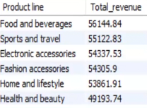
Product Analysis
Conduct analysis on the data to understand the different product lines. They are –
Electronic accessories
Food and beverages
Fashion accessories
Home and lifestyle
Health and beauty
Sports and travel

Slide 29



Product Analysis
POSITION | Description | SALES(QTY.)
FIRST | Fashion accessories | 178
SECOND | Food and beverages | 174
LEAST | Health and beauty | 152

Slide 30


Product Analysis
Most female buy products from fashion accessories product line whereas most male buy from health and beauty.
Health and beauty product line sales has to be improved as total sales as below average.

Slide 31
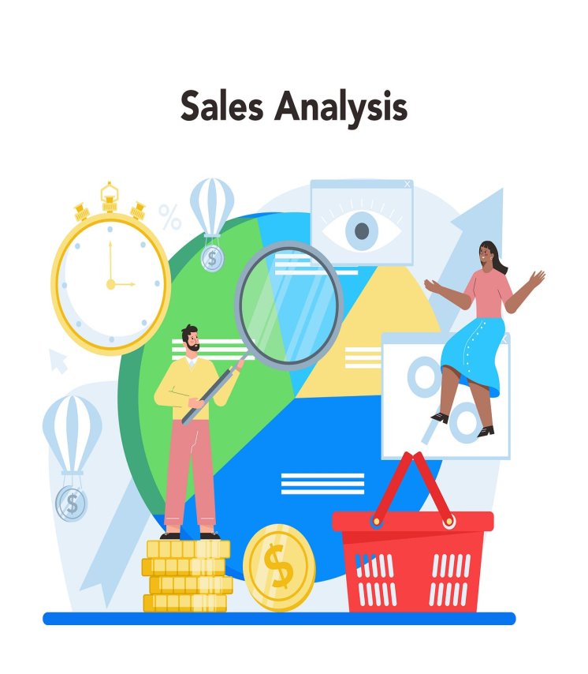

SALES ANALYSIS
Sales occurrences for each time of day on every weekday.
Most of the sales occurred in Wednesday afternoon.

Slide 32



SALES ANALYSIS
In January month revenue is highest while in February the revenue is lowest and in March it has been increased again.
The city Naypyitaw generated the highest revenue.
Most customers are using E-Wallet payment method.

Slide 33


SALES ANALYSIS
Branch A is doing good as it exceeded the average number whereas the product sold from Branch B is lowest.
Food and Beverages generated the highest sales and highest revenue.

Slide 34


CUSTOMER ANALYSIS
Most Females buy products from Fashion accessories product line whereas most Males buy from Health and Beauty.
Most females has purchased from C branch and males from A branch.

Slide 35



CUSTOMER ANALYSIS
Females are predominant gender in customers.
Among all customer type, members are purchasing more from amazon.

Slide 36

SUGGESTIONS
Customer feedback can identify opportunities you hadn't considered, which can turn into new sales.
Invest in product quality investments, packaging enhancements and branding initiatives to enhance perceived value and customer satisfaction.

Slide 37
SUGGESTIONS
Customers are a company's most important asset. Understanding their needs, pain points, challenges, fears, and desires.
Address any quality issues, durability concerns or usability challenges to build trust and loyalty among customers.
Companies often offer discounts to encourage customers to make larger purchases.

Slide 38


